Slide 1
Innovate to Communicate
Health Literacy Workforce Training
Carol J. Howe, PhD, RN, CDCES, FAAN
Teresa Wagner, DrPH, MS, CPH, RDN/LD, CHWI
Tracine Adame, BSN, RN
Ashley Franklin, PhD, RN, CNE, CHSE

Slide 2
Innovate to Communicate
Workshop Objectives
Communicate using evidence based health literacy practices e.g. plain language, chunking information, teach back.
Focus attention on ways to integrate health literacy into structures, processes, and quality measures.
Effectively use health literacy resources to promote a health literate organization.

Slide 3
Why Health Literacy Training?
1 in 3 patients has low health literacy
Increased and longer hospitalizations
Difficulty managing chronic conditions
Medication error prevalence
Increased mortality
Avoidable readmissions
Emergency Room increased utilization
$215 billion annually (Rasu, 2015)
Notes:
Discuss the importance of health literacy in terms of patient care (review information on the slide).
Source: USU Center for Health Disparities [Research and Education], Health Literacy Presentation by Jaime R. Lanier, MPH Director of Community Outreach & Eduardo Pezo, MPH

Slide 4

Healthy People 2030:
Health Literacy Definitions
Personal health literacy is the degree to which individuals have the ability to find, understand, and use information and services to inform health-related decisions and actions for themselves and others.
Organizational health literacy is the degree to which organizations equitably enable individuals to find, understand, and use information and services to inform health-related decisions and actions for themselves and others.

Slide 5
The New Definitions:
Emphasize people’s ability to use health information rather than just understand it
Focus on the ability to make “well-informed” decisions rather than “appropriate” ones
Incorporate a public health perspective
Acknowledge that organizations have a responsibility to address health literacy
How does your organization meet these goals?

Slide 6
Innovate to Communicate: Overview
Training for all health care disciplines in clinical and leadership roles
Engaging self-learning modules
Exemplar videos
Clinician-patient role play
Communication observation and self-assessment check list
Interactive quizzes

Slide 7

Self-learning Modules
- Health Literacy 101 and CLAS Standards
- Health Literacy for Leadership

Slide 8
Medicine Review
Identify medicines patient should bring
Remind patient to bring medicines
Set out all medicines
Perform the review
  Ask the patient to pick up each medicine bottle, ask:
    What do you take this medicine for?
    When do you take this medicine?
    Can you show me how much you take each time?
Clarify medicine instructions
  When find a problem, try to find out why
  Provide correct instructions
  Use a teach back to ensure comprehension
https://www.ahrq.gov/health-literacy/improve/precautions/tool8.html

Slide 9
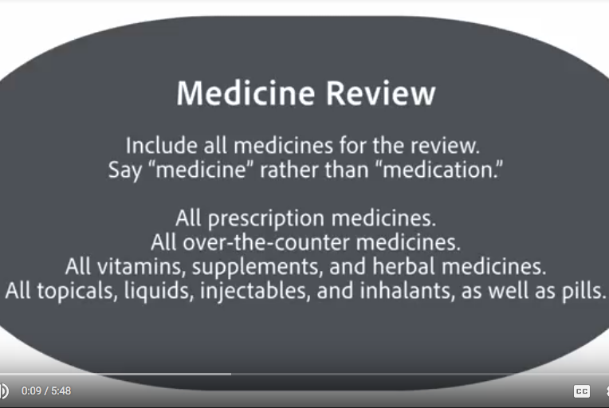
Innovate to Communicate
Medicine Review Video

Slide 10
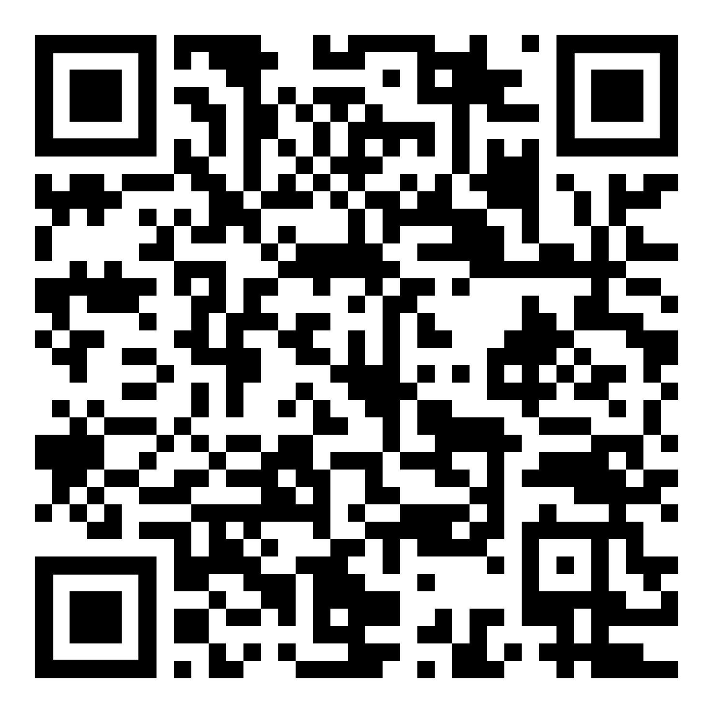
Adult Medicine Review
Patient Case
68 year old with diabetes, hypertension, and high cholesterol
New Rx Lomitapide (Juxtapid) started 2 weeks ago for cholesterol
Provider tasks
Organize a medicine review, chunk meds from this list
Emphasize 1 to 3 key points
Observer role
  Communication Observation Form https://www.ahrq.gov/health-literacy/improve/precautions/tool4c.html
  Communication Self-Assessment https://www.ahrq.gov/health-literacy/improve/precautions/tool4b.html
  Patient Feedback Form https://www.ahrq.gov/health-literacy/improve/precautions/tool4d.html

Slide 11
Teach Back
This is not a test of patient knowledge
This is a test on how well you explained
Find a way that you like to ask for a teach back
  We covered a lot today, I want to make sure I was clear. Can you tell me in your own words, what you are going to do to ….
Chunk and check
Clarify and check again (if discover misunderstanding)
Try it with one patient and scale up
https://www.ahrq.gov/health-literacy/improve/precautions/tool5.html

Slide 12
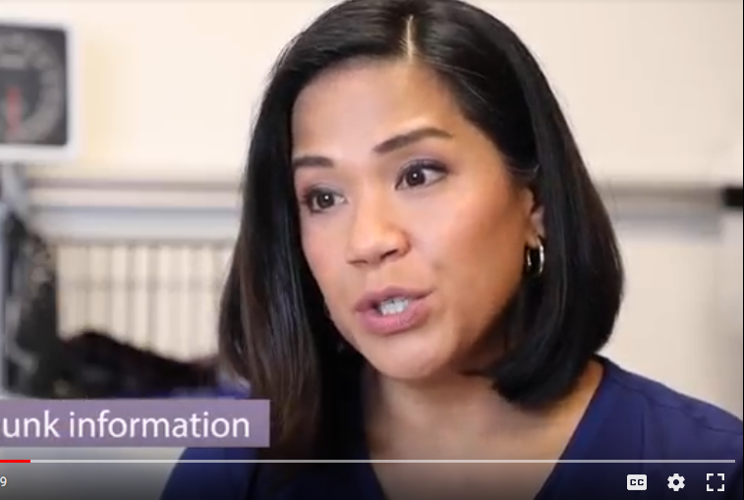
Teach Back Video
Innovate to Communicate

Slide 13
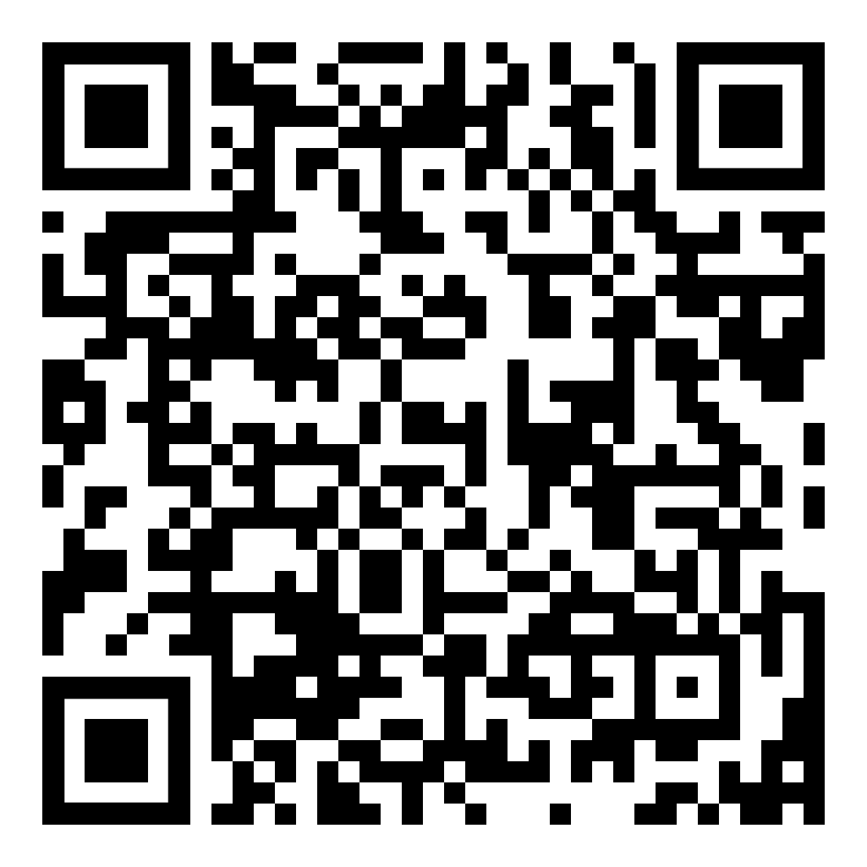
Pediatric Teach Back Scenario
Patient Case
Parent of 9 year old boy post-op tonsillectomy/adenoidectomy
Discharge to home
Pain management a concern
Provider Tasks
Take a few minutes to plan your teaching.
Make only 1-3 points before checking for comprehension
Do a teach back to make sure you were clear.
Observer Role
Communication Observation Form https://www.ahrq.gov/health-literacy/improve/precautions/tool4c.html
Communication Self-Assessment https://www.ahrq.gov/health-literacy/improve/precautions/tool4b.html
Patient Feedback Form https://www.ahrq.gov/health-literacy/improve/precautions/tool4d.html

Slide 14


(Please download the App!)
Let's play! Kahoot!

Slide 15

Innovate to Communicate: Implement
Participant Evaluation
Participants identify one immediate practice change
Question and answer time
Complete workshop evaluations

Slide 16
Innovate to Communicate: Trainer Evaluation

Slide 17


Collaborative Partners
This project was supported by the National Network of the Libraries of Medicine under Award Number 1UG4LM012345-01.
The content is solely the responsibility of the authors and does not necessarily represent the official views of the National Institutes of Medicine.

Slide 18

Innovate to Communicate: Resources
Review Agency for Healthcare Research and Quality Health Literacy Universal Precautions Toolkit https://www.ahrq.gov/health-literacy/improve/precautions/appx.html
Provide AHRQ resources
  Communication Observation Form https://www.ahrq.gov/health-literacy/improve/precautions/tool4c.html
  Communication Self-Assessment https://www.ahrq.gov/health-literacy/improve/precautions/tool4b.html
  Patient Feedback Form https://www.ahrq.gov/health-literacy/improve/precautions/tool4d.html
Review MedlinePlus https://medlineplus.gov/
Discuss opportunities to incorporate tools in your organization!

